Slide 1
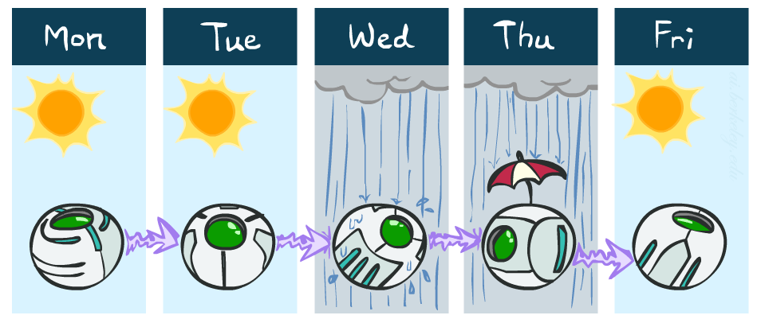
Example: Weather
States {rain, sun}
Initial distribution P(X₀)
Transition model P(X_{t} | X_{t-1})
P(X₀)
sun | rain
0.5 | 0.5
Two new ways of representing the same CPT
0.9
0.3
0.9
X_{t-1} | P(X_{t}|X_{t-1})
 | sun | rain
sun | 0.9 | 0.1
rain | 0.3 | 0.7
rain
sun
sun
sun
0.1
0.3
rain
rain
0.7
0.7
0.1

Slide 2

Weather prediction
X_{t-1} | P(X_{t}|X_{t-1})
 | sun | rain
sun | 0.9 | 0.1
rain | 0.3 | 0.7
Time 0: <0.5,0.5>
What is the weather like at time 1?
P(X₁) = ∑_{x0} P(X₁,X₀=x₀)
= ∑_{x0} P(X₀=x₀) P(X₁| X₀=x₀)
= 0.5<0.9,0.1> + 0.5<0.3,0.7> = <0.6,0.4>

Slide 3
Weather prediction, contd.
X_{t-1} | P(X_{t}|X_{t-1})
 | sun | rain
sun | 0.9 | 0.1
rain | 0.3 | 0.7
Time 1: <0.6,0.4>
What is the weather like at time 2?
P(X₂) = ∑_{x1} P(X₂,X₁=x₁)
= ∑_{x1} P(X₁=x₁) P(X₂| X₁=x₁)
= 0.6<0.9,0.1> + 0.4<0.3,0.7> = <0.66,0.34>

Slide 4
Weather prediction, contd.
X_{t-1} | P(X_{t}|X_{t-1})
 | sun | rain
sun | 0.9 | 0.1
rain | 0.3 | 0.7
Time 2: <0.66,0.34>
What is the weather like at time 3?
P(X₃) = ∑_{x2} P(X₃,X₂=x₂)
= ∑_{x2} P(X₂=x₂) P(X₃| X₂=x₂)
= 0.66<0.9,0.1> + 0.34<0.3,0.7> = <0.696,0.304>

Slide 5
Forward algorithm (simple form)
What is the state at time t?
P(X_{t}) = ∑_{xt-1} P(X_{t},X_{t-1}=x_{t-1})
= ∑_{xt-1} P(X_{t-1}=x_{t-1}) P(X_{t}| X_{t-1}=x_{t-1})
Iterate this update starting at t=0
This is called a recursive update: P_{t} = g(P_{t-1}) = g(g(g(g( …P₀))))
Probability from previous iteration
Transition model

Slide 6
And the same thing in linear algebra
What is the weather like at time 2?
P(X₂) = 0.6<0.9,0.1> + 0.4<0.3,0.7> = <0.66,0.34>
In matrix-vector form:
P(X₂) = ( ) ( ) = ( )
I.e., multiply by T^{T}, transpose of transition matrix
X_{t-1} | P(X_{t}|X_{t-1})
 | sun | rain
sun | 0.9 | 0.1
rain | 0.3 | 0.7
0.9 0.3
0.1 0.7
0.6
0.4
0.66
0.34

Slide 7

Stationary Distributions
The limiting distribution is called the stationary distribution P∞ of the chain
It satisfies P∞ = P_{∞+1} = T^{T} P∞
Solving for P∞ in the example:
( ) ( ) = ( )
0.9p + 0.3(1-p) = p
p = 0.75
Stationary distribution is <0.75,0.25> regardless of starting distribution
0.9 0.3
0.1 0.7
p
1-p
p
1-p

Slide 8

Hidden Markov Models

Slide 9
Hidden Markov Models
Usually the true state is not observed directly
Hidden Markov models (HMMs)
Underlying Markov chain over states X
You observe evidence E at each time step
X_{t} is a single discrete variable; E_{t} may be continuous and may consist of several variables
X₀
X₁
X₂
X₃
X₅
E₁
E₂
E₃
E₅

Slide 10

Example: Weather HMM
An HMM is defined by:
Initial distribution: P(X₀)
Transition model: P(X_{t}| X_{t-1})
Sensor model: P(E_{t}| X_{t})
W_{t-1} | P(W_{t}|W_{t-1})
 | sun | rain
sun | 0.9 | 0.1
rain | 0.3 | 0.7
Weather_{t-1}
Weather_{t}
Weather_{t+1}
W_{t} | P(U_{t}|W_{t})
 | true | false
sun | 0.2 | 0.8
rain | 0.9 | 0.1
Umbrella_{t-1}
Umbrella_{t}
Umbrella_{t+1}
Notes:
demo

Slide 11
HMM as probability model
Joint distribution for Markov model: P(X₀,…, X_{T}) = P(X₀) ∏_{t=1:T} P(X_{t} | X_{t-1})
Joint distribution for hidden Markov model: P(X₀,X₁,…, X_{T},E_{T}) = P(X₀) ∏_{t=1:T} P(X_{t} | X_{t-1}) P(E_{t} | X_{t})
Future states are independent of the past given the present
Current evidence is independent of everything else given the current state
Are evidence variables independent of each other?
X₀
X₁
X₂
X₃
X₅
Useful notation:
X_{a:b} = X_{a} , X_{a+1}, …, X_{b}
E₁
E₂
E₃
E₅
Notes:
Add conditional independence consequences here

Slide 12
Real HMM Examples
Speech recognition HMMs:
Observations are acoustic signals (continuous valued)
States are specific positions in specific words (so, tens of thousands)
Machine translation HMMs:
Observations are words (tens of thousands)
States are translation options
Robot tracking:
Observations are range readings (continuous)
States are positions on a map (continuous)
Molecular biology:
Observations are nucleotides ACGT
States are coding/non-coding/start/stop/splice-site etc.

Slide 13
Inference tasks
Filtering: P(X_{t}|e_{1:t})
belief state—input to the decision process of a rational agent
Prediction: P(X_{t+k}|e_{1:t}) for k > 0
evaluation of possible action sequences; like filtering without the evidence
Smoothing: P(X_{k}|e_{1:t}) for 0 ≤ k < t
better estimate of past states, essential for learning
Most likely explanation: arg max_{x1:t} P(x_{1:t} | e_{1:t})
speech recognition, decoding with a noisy channel

Slide 14
Inference tasks
Filtering: P(X_{t}|e_{1:t})
Prediction: P(X_{t+k}|e_{1:t})
X₁
X₂
X₃
X₄
X₁
X₂
X₃
X₄
e₁
e₂
e₃
e₄
e₁
e₂
e₃
Smoothing: P(X_{k}|e_{1:t}), k<t
Explanation: P(X_{1:t}|e_{1:t})
X₁
X₂
X₃
X₄
X₁
X₂
X₃
X₄
e₁
e₂
e₃
e₄
e₁
e₂
e₃
e₄

Slide 15
Filtering / Monitoring
Filtering, or monitoring, or state estimation, is the task of maintaining the distribution f_{1:t} = P(X_{t}|e_{1:t}) over time
We start with f₀ in an initial setting, usually uniform
Filtering is a fundamental task in engineering and science
The Kalman filter (continuous variables, linear dynamics, Gaussian noise) was invented in 1960 and used for trajectory estimation in the Apollo program; core ideas used by Gauss for planetary observations; 788,000 papers on Google Scholar
Notes:
Dan has some demo for this

Slide 16
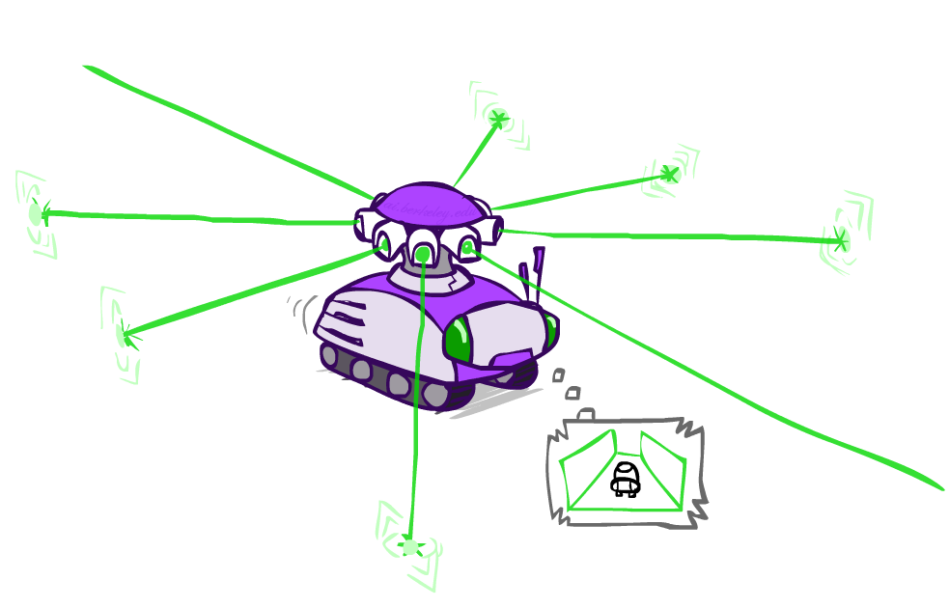
Example: Robot Localization
Example from Michael Pfeiffer
Prob
0
1
t=0
Sensor model: four bits for wall/no-wall in each direction, never more than 1 mistake
Transition model: action may fail with small prob.

Slide 17
Example: Robot Localization
Prob
0
1
t=1
Lighter grey: was possible to get the reading,
but less likely (required 1 mistake)

Slide 18
Example: Robot Localization
Prob
0
1
t=2

Slide 19
Example: Robot Localization
Prob
0
1
t=3

Slide 20
Example: Robot Localization
Prob
0
1
t=4

Slide 21
Example: Robot Localization
Prob
0
1
t=5

Slide 22
Filtering algorithm
Aim: devise a recursive filtering algorithm of the form
P(X_{t+1}|e_{1:t+1}) = g(e_{t+1}, P(X_{t}|e_{1:t}) )
P(X_{t+1}|e_{1:t+1}) =

Slide 23
Filtering algorithm
Aim: devise a recursive filtering algorithm of the form
P(X_{t+1}|e_{1:t+1}) = g(e_{t+1}, P(X_{t}|e_{1:t}) )
P(X_{t+1}|e_{1:t+1}) = P(X_{t+1}|e_{1:t}, e_{t+1})
= α P(e_{t+1}|X_{t+1}, e_{1:t}) P(X_{t+1}| e_{1:t})
= α P(e_{t+1}|X_{t+1}) P(X_{t+1}| e_{1:t})
= α P(e_{t+1}|X_{t+1}) ∑_{xt} P(x_{t} | e_{1:t}) P(X_{t+1}| x_{t}, e_{1:t})
= α P(e_{t+1}|X_{t+1}) ∑_{xt} P(x_{t} | e_{1:t}) P(X_{t+1}| x_{t})
Apply Bayes’ rule
Apply conditional independence
Condition on X_{t}
Apply conditional
independence
Normalize
Update
Predict

Slide 24


Filtering algorithm
P(X_{t+1}|e_{1:t+1}) = α P(e_{t+1}|X_{t+1}) ∑_{xt} P(x_{t} | e_{1:t}) P(X_{t+1}| x_{t})
f_{1:t+1} = Forward(f_{1:t} , e_{t+1})
Cost per time step: O(|X|²) where |X| is the number of states
Time and space costs are constant, independent of t
O(|X|²) is infeasible for models with many state variables
We get to invent really cool approximate filtering algorithms
Normalize
Update
Predict

Slide 25
And the same thing in linear algebra
Transition matrix T, observation matrix O_{t}
Observation matrix has state likelihoods for E_{t} along diagonal
E.g., for U₁ = true, O₁ = ( )
Filtering algorithm becomes
f_{1:t+1} = α O_{t+1}T^{T} f_{1:t}
0.2 0
0 0.9
X_{t-1} | P(X_{t}|X_{t-1})
 | sun | rain
sun | 0.9 | 0.1
rain | 0.3 | 0.7
W_{t} | P(U_{t}|W_{t})
 | true | false
sun | 0.2 | 0.8
rain | 0.9 | 0.1

Slide 26
Example: Weather HMM
0.6
0.4
0.45
0.55
predict
predict
update
update
W_{t-1} | P(W_{t}|W_{t-1})
 | sun | rain
sun | 0.9 | 0.1
rain | 0.3 | 0.7
f(sun) = 0.5
f(rain) = 0.5
f(sun) = 0.25
f(rain) = 0.75
f(sun) = 0.154
f(rain) = 0.846
Weather₀
Weather₁
Weather₂
W_{t} | P(U_{t}|W_{t})
 | true | false
sun | 0.2 | 0.8
rain | 0.9 | 0.1
P(W₀)
sun | rain
0.5 | 0.5
Umbrella₁
Umbrella₂
Notes:
Fix numbers

Slide 27
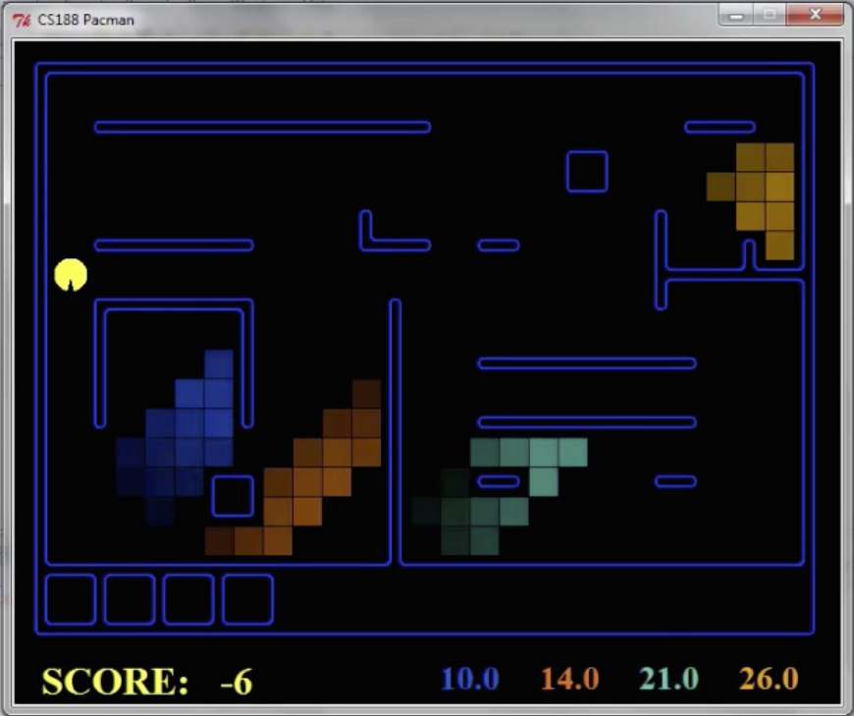
Pacman – Hunting Invisible Ghosts with Sonar
[Demo: Pacman – Sonar – No Beliefs(L14D1)]

Slide 28

Video of Demo Pacman – Sonar

Slide 29

Most Likely Explanation

Slide 30
Inference tasks
Filtering: P(X_{t}|e_{1:t})
belief state—input to the decision process of a rational agent
Prediction: P(X_{t+k}|e_{1:t}) for k > 0
evaluation of possible action sequences; like filtering without the evidence
Smoothing: P(X_{k}|e_{1:t}) for 0 ≤ k < t
better estimate of past states, essential for learning
Most likely explanation: arg max_{x1:t} P(x_{1:t} | e_{1:t})
speech recognition, decoding with a noisy channel

Slide 31
Most likely explanation = most probable path
arg max_{x1:t} P(x_{1:t} | e_{1:t})
= arg max_{x1:t} α P(x_{1:t} , e_{1:t})
= arg max_{x1:t} P(x_{1:t} , e_{1:t})
= arg max_{x1:t} P(x₀) ∏_{t} P(x_{t} | x_{t-1}) P(e_{t} | x_{t})
State trellis: graph of states and transitions over time
Each arc represents some transition x_{t-1} → x_{t}
Each arc has weight P(x_{t} | x_{t-1}) P(e_{t} | x_{t}) (arcs to initial states have weight P(x₀) )
The product of weights on a path is proportional to that state sequence’s probability
Forward algorithm computes sums of paths, Viterbi algorithm computes best paths
sun
sun
sun
sun
rain
rain
rain
rain
X₀ X₁ … X_{T}

Slide 32
Forward / Viterbi algorithms
sun
sun
sun
sun
rain
rain
rain
rain
X₀ X₁ … X_{T}
Forward Algorithm (sum)
For each state at time t, keep track of the total probability of all paths to it
Viterbi Algorithm (max)
For each state at time t, keep track of the maximum probability of any path to it
f_{1:t+1} = Forward(f_{1:t} , e_{t+1})
= α P(e_{t+1}|X_{t+1}) ∑_{xt} P(X_{t+1}| x_{t}) f_{1:t}
m_{1:t+1} = Viterbi(m_{1:t} , e_{t+1})
= P(e_{t+1}|X_{t+1}) max_{xt} P(X_{t+1}| x_{t}) m_{1:t}

Slide 33
Viterbi algorithm contd.
W_{t-1} | P(W_{t}|W_{t-1})
 | sun | rain
sun | 0.9 | 0.1
rain | 0.3 | 0.7
0.5
sun
0.18
0.72
0.18
0.5
sun
sun
sun
0.09
0.076
0.0136080
0.09
0.01
0.09
0.06
0.24
0.06
0.5
rain
rain
rain
rain
0.5
0.315
0.022
0.0138495
0.63
0.07
0.63
W_{t} | P(U_{t}|W_{t})
 | true | false
sun | 0.2 | 0.8
rain | 0.9 | 0.1
X₀ X₁ X₂ X_{T}
U₁=true U₂=false U₃=true
Time complexity?
O(|X|² T)
Space complexity?
O(|X| T)
Number of paths?
O(|X|^{T})

Slide 34
Viterbi in negative log space
W_{t-1} | P(W_{t}|W_{t-1})
 | sun | rain
sun | 0.9 | 0.1
rain | 0.3 | 0.7
1.0
sun
2.47
sun
0.72
sun
2.47
sun
S
3.47
6.64
3.47
4.06
2.06
4.06
1.0
rain
rain
rain
rain
0.67
3.84
0.67
W_{t} | P(U_{t}|W_{t})
 | true | false
sun | 0.2 | 0.8
rain | 0.9 | 0.1
G
argmax of product of probabilities
= argmin of sum of negative log probabilities
= minimum-cost path
Viterbi is essentially breadth-first graph search
What about A*?

